Slide 1

Google Quest Q&A Classification
GROUP 2
Tram Ngoc Le (Jennie)
Bingyue Zeng (Anna)
Xuejun Shen (Shirley)
Annuo Qian (Alice)
Yanqi Shi (Chris)

Slide 2
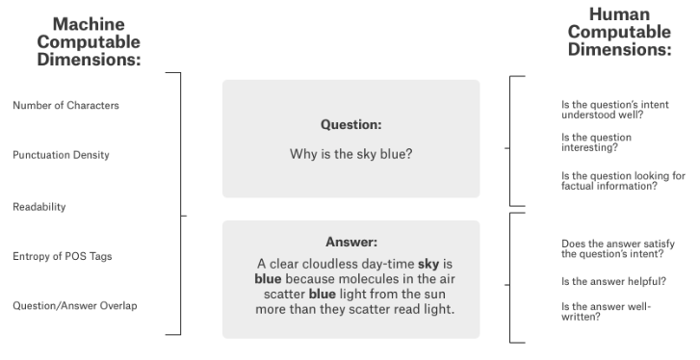
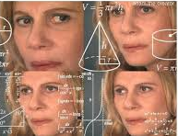
Background
Computers are good at answering questions with single, verifiable answers
Humans are better at subjective questions that require a multidimensional understanding of context

Slide 3
PROBLEM STATEMENT
What are we proposed to do ?
Why is this important ?
Contribute to Q&A Systems research by making the system become more human-like.
Build classification models for Google Q&A to:
Part1: Classify 5 categories for question, answer.
Part2: Classify types for question, answer.
Compare different models to identify the most efficient subjective question-answering categories and types algorithms
Notes:
Identify a better subjective question-answering topics and types algorithms

Slide 4
GOOGLE QUEST Q&A LABELLING DATASET
Data Collection
Source: Kaggle Competition
Collected by CrowdSource team at Google Research from various Stack Exchange properties
The question-answer pairs were gathered from 70 websites
Data Description
Train.csv: 6K pairs of question-answer (Answers with duplicate questions)
Test.csv: 477 pairs of question-answer (No duplicated records)
Format: One record contains one answer, one question, category, types, and other features (metadata) about the Q&A pair

Slide 5
METHODOLOGY DIAGRAM
Naïve Bayes
SVM
Random Forest
Decision Tree
Variable Selection
Feature Engineering
Model Building
Model Selection
Model Evaluation
Oversampling Training
Text Preprocessing
Part I Category/Topic Classification
Artificial Neural Network
LSTM
SVM
Naïve Bayes
Part II Q&A Types Classification

Slide 6
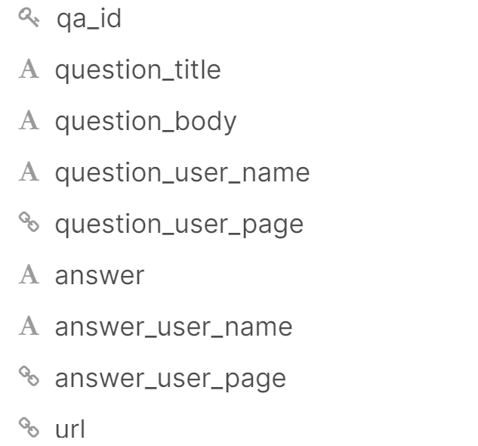
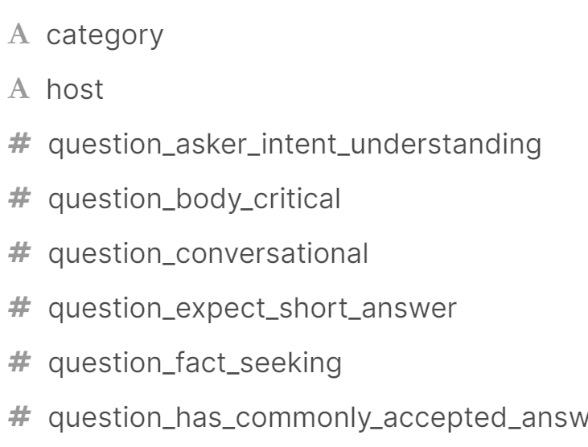
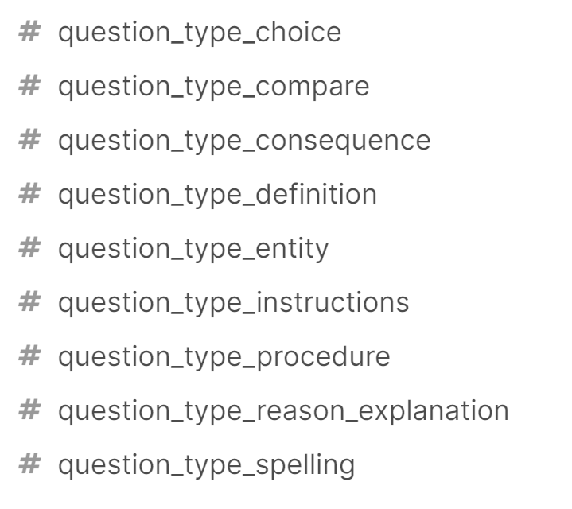
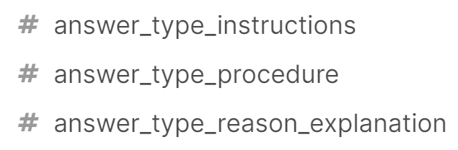
VARIABLES SELECTION
Inputs
PART1:
Category classification target
Main inputs
question_title
question_body
answer
Target
category
question_type_mixed
answer_type_mixed
PART2:
Q&A type classification target
Manually labeled the target based on the probability types into question type mixed & answer type mixed
Notes:
We don’t have 12 targets – we only have three target – for part 2 we will manually label those target into two

Slide 7
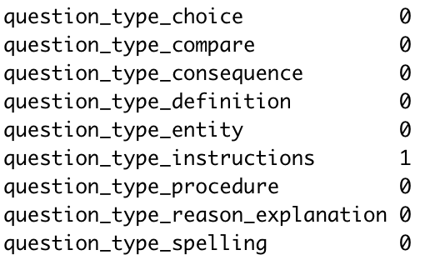
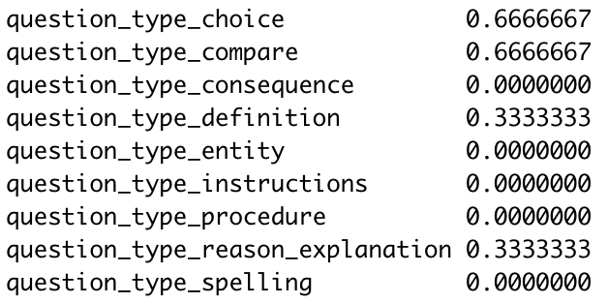
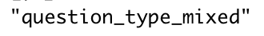
Q&A TYPE LABELING
In the raw data, different values are assigned to each type for every question or answer. To make the data applicable to a classification model, we label the type based on the values.
New target columns: answer_target_mixed, question_target_mixed – Target for Question & Type Classification

Slide 8
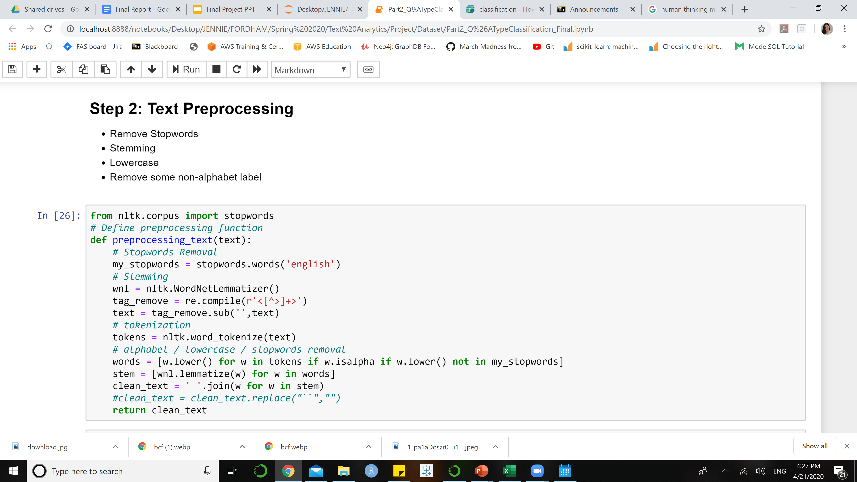
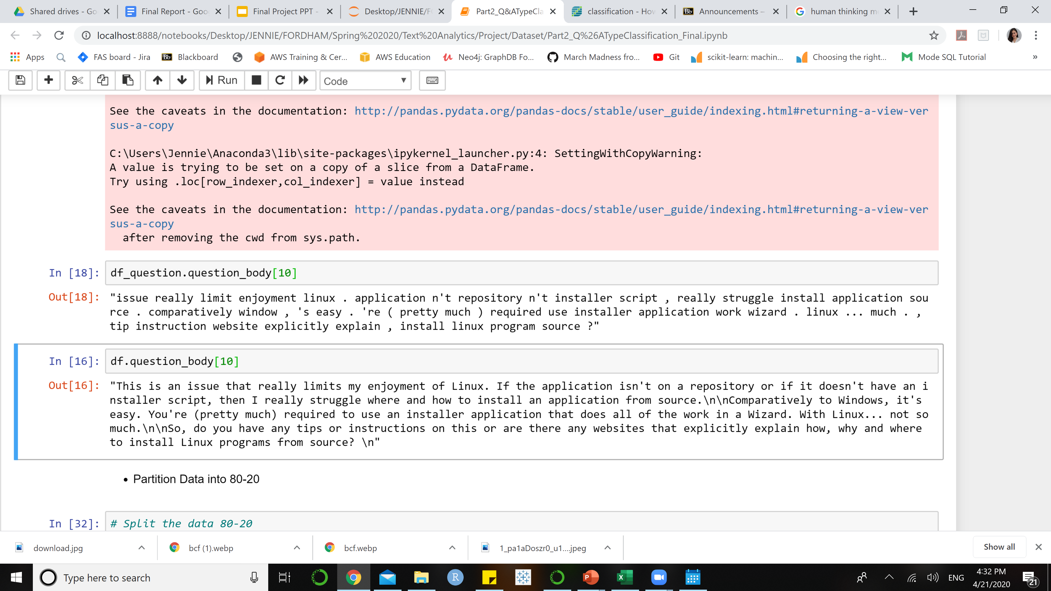
DATA PREPROCESSING
Lowercase
Stemming
Stop-words removal
Remove some tag, non-alphabet character
Notes:
Q&A labeling serves for question and answer type classification – we will create a 2 new columns for question and answer type labels based on the probability scores of each Q&A type provided by the train dataset

Slide 9
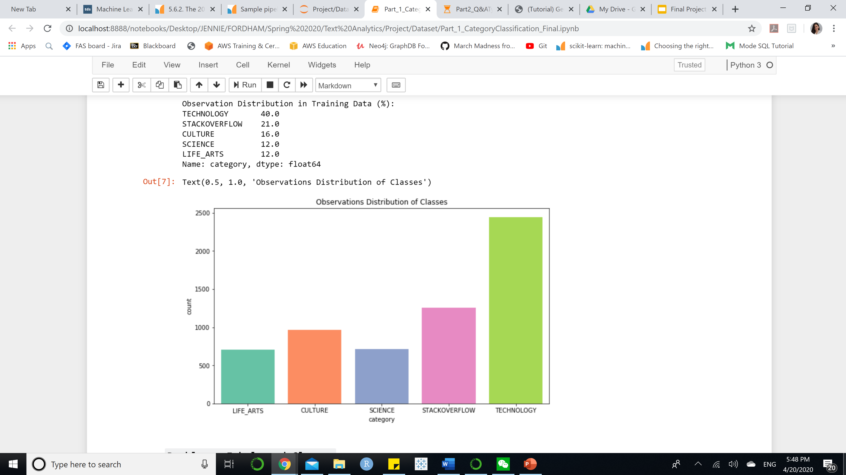
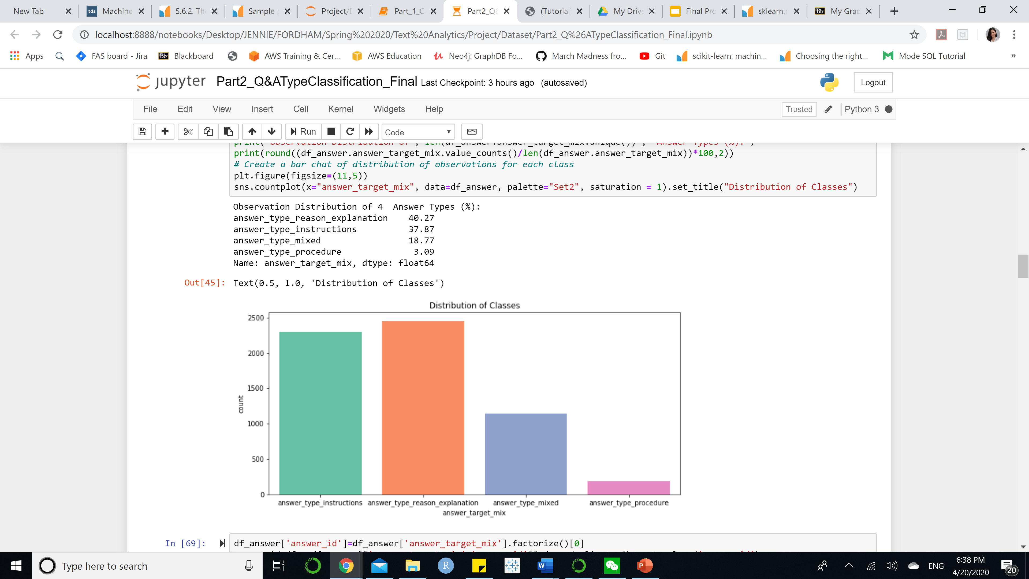
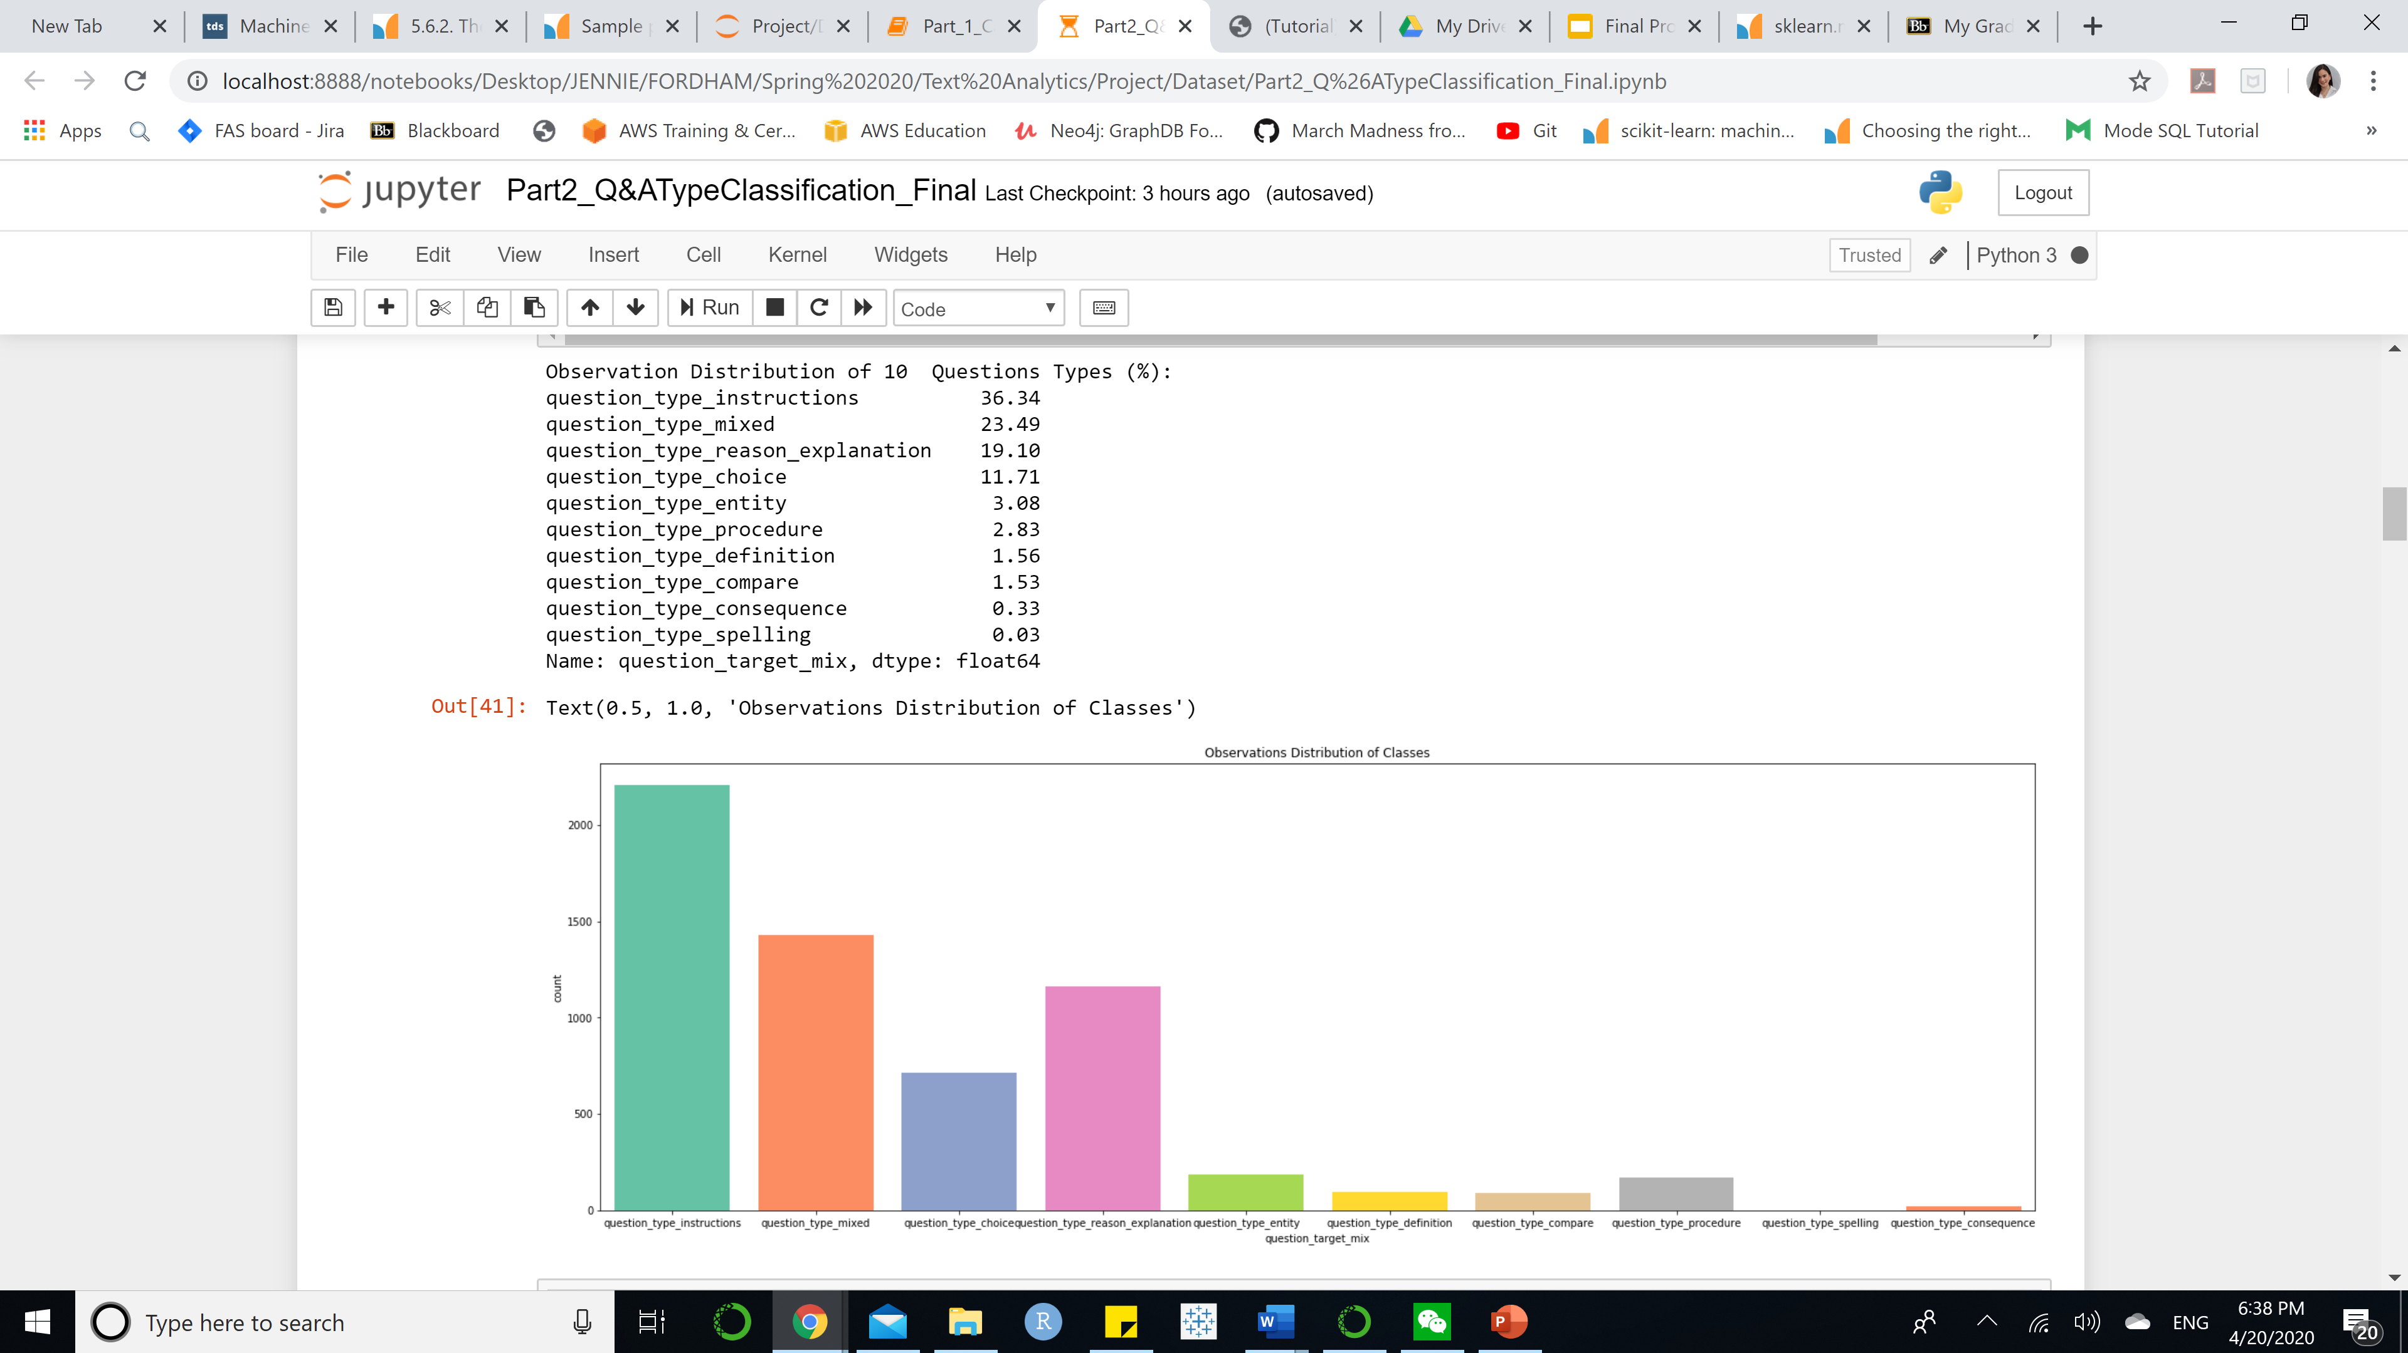
Data Exploratory Analysis | Target Distribution
Q&A Category Classification
Q&A Type Classification
Problem: Unbalanced Classes
Observations are not equally distributed among classes regarding Q&A Category and Q&A Type Classification
Extremely affect the accuracy rate of the model – the model can be bias towards the target with more observation
Solution: Over-sampling
Randomly oversampling all observations regarding each target to balance the distribution between classes – Perform later after feature engineering

Slide 10
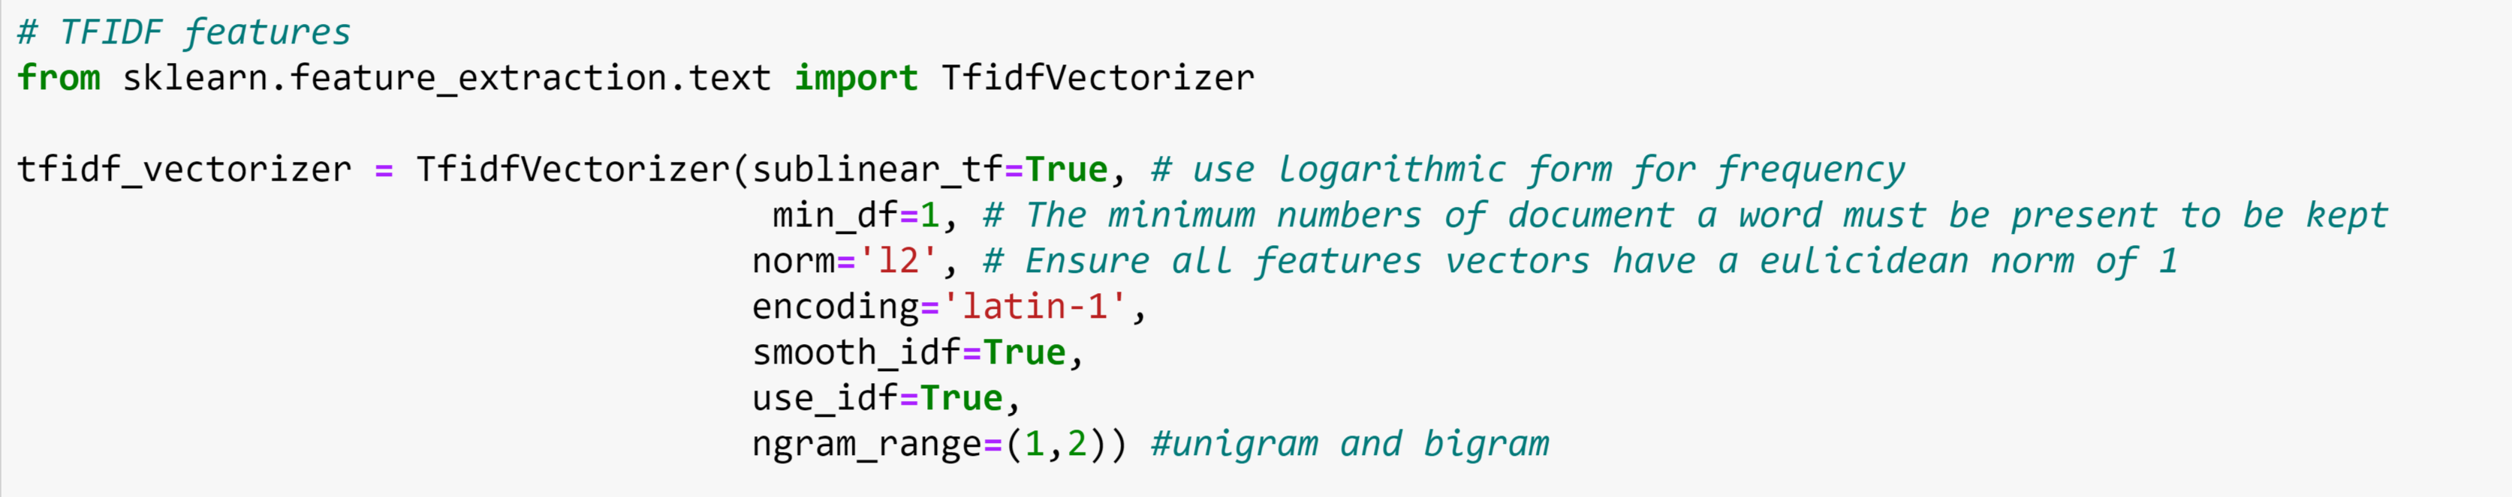
FEATURE ENGINEERING - TFIDF
Logarithmic Form of Frequency
(Normalization)
Minimum numbers of document a word must be present to be kept is 1
Unigram vs Bigram
Combination
Features Vector with Euclidean norm of 1
Notes:
Q&A labeling serves for question and answer type classification – we will create a 2 new columns for question and answer type labels based on the probability scores of each Q&A type provided by the train dataset

Slide 11
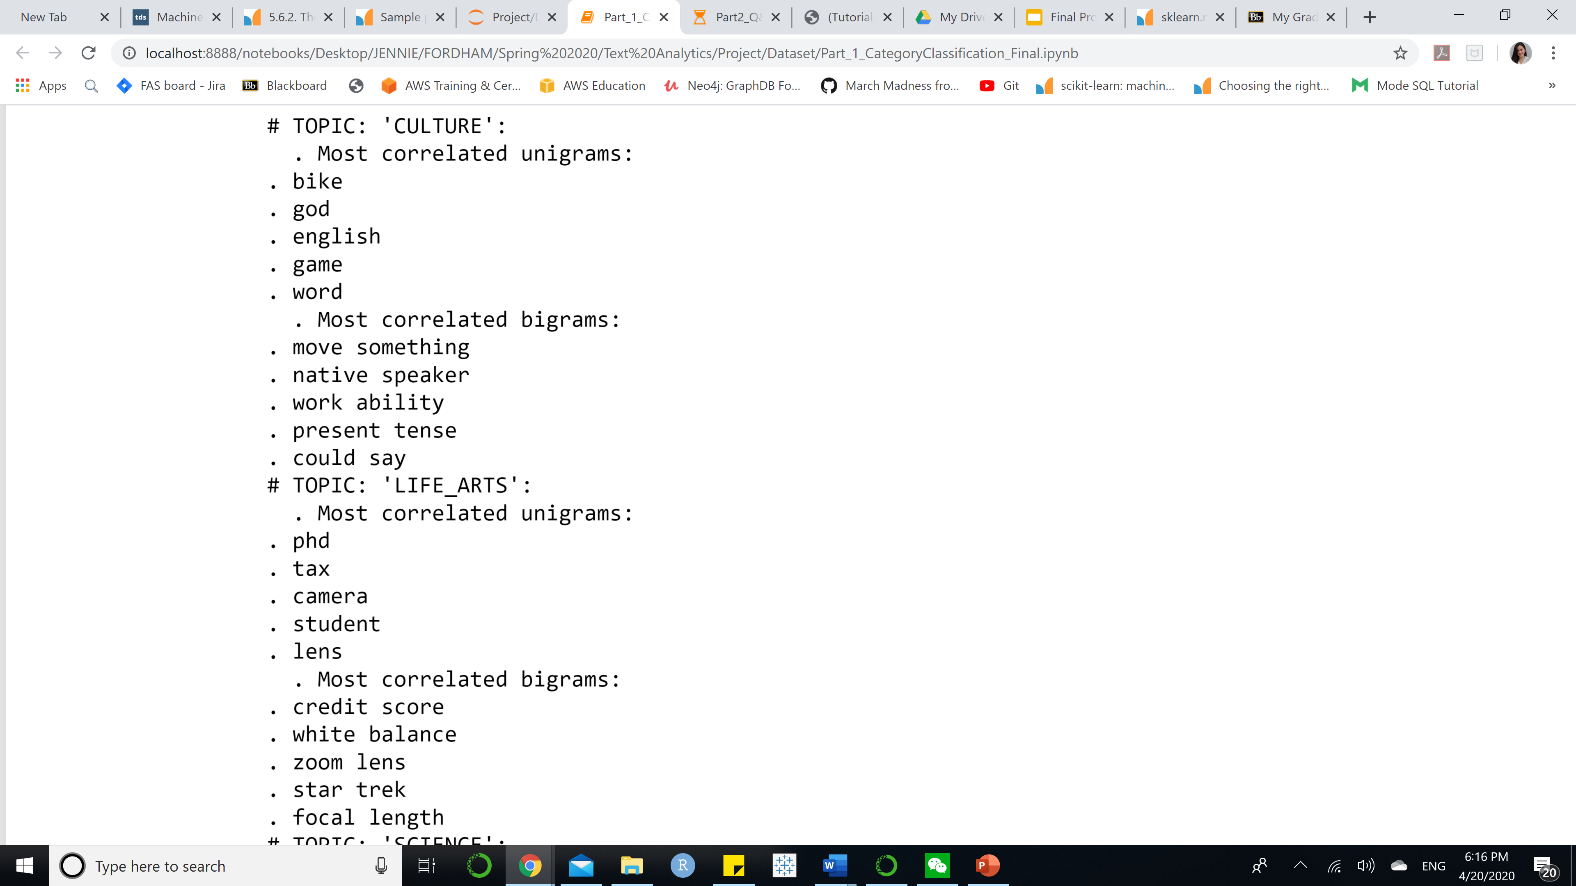
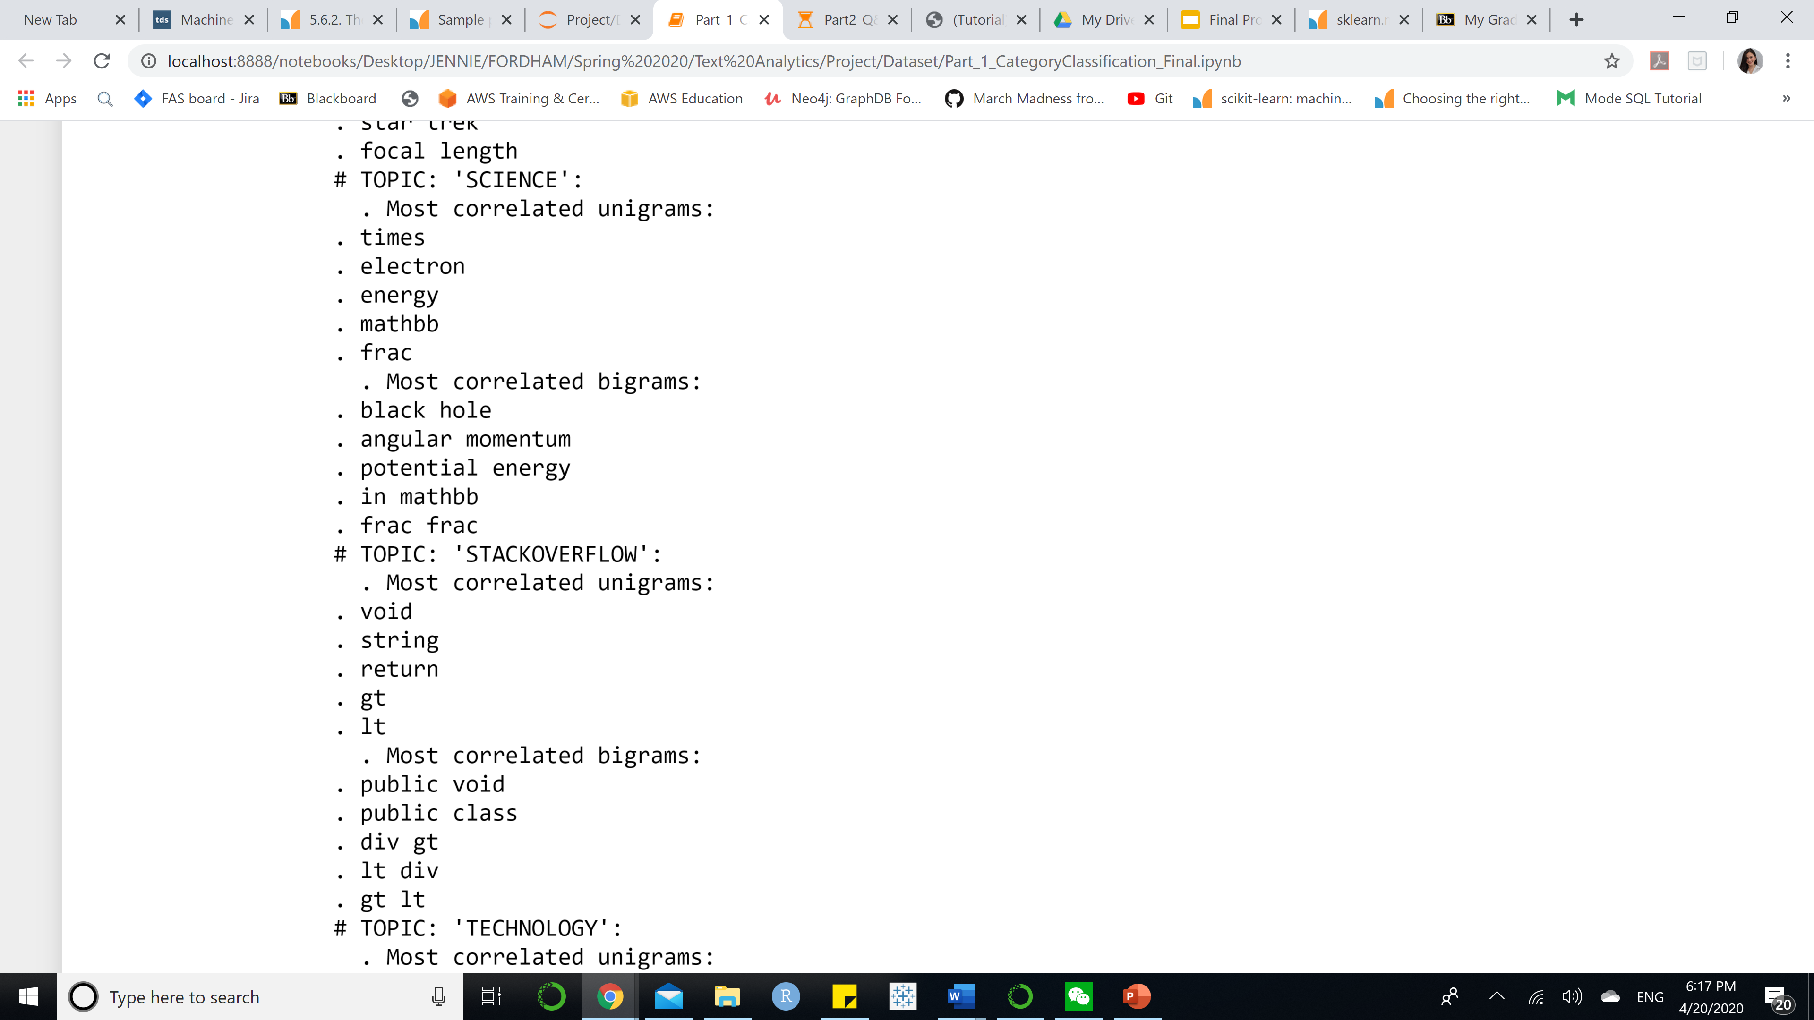
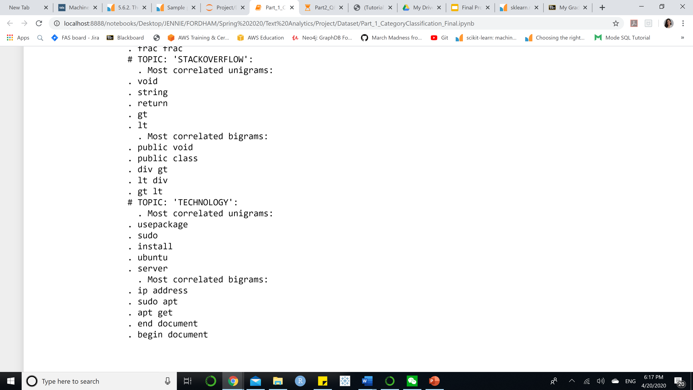
Example
Top Words Most Correlated TFIDF Unigram/Bigram of
Category Classification for Answer
Notes:
This slides cover an example of top most correlated TFIDF unigram and bigram regarding Answer

Slide 12
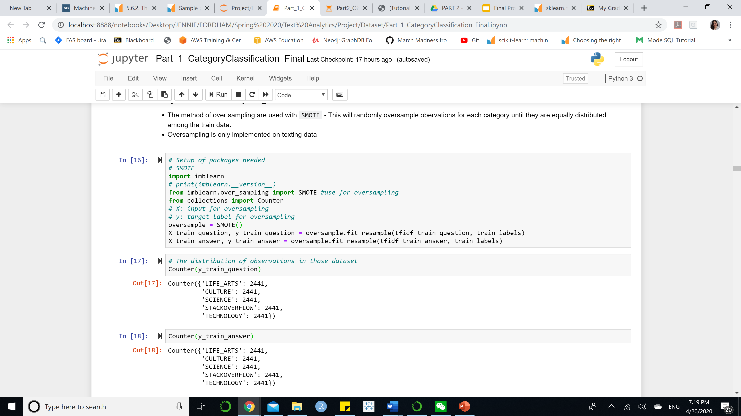
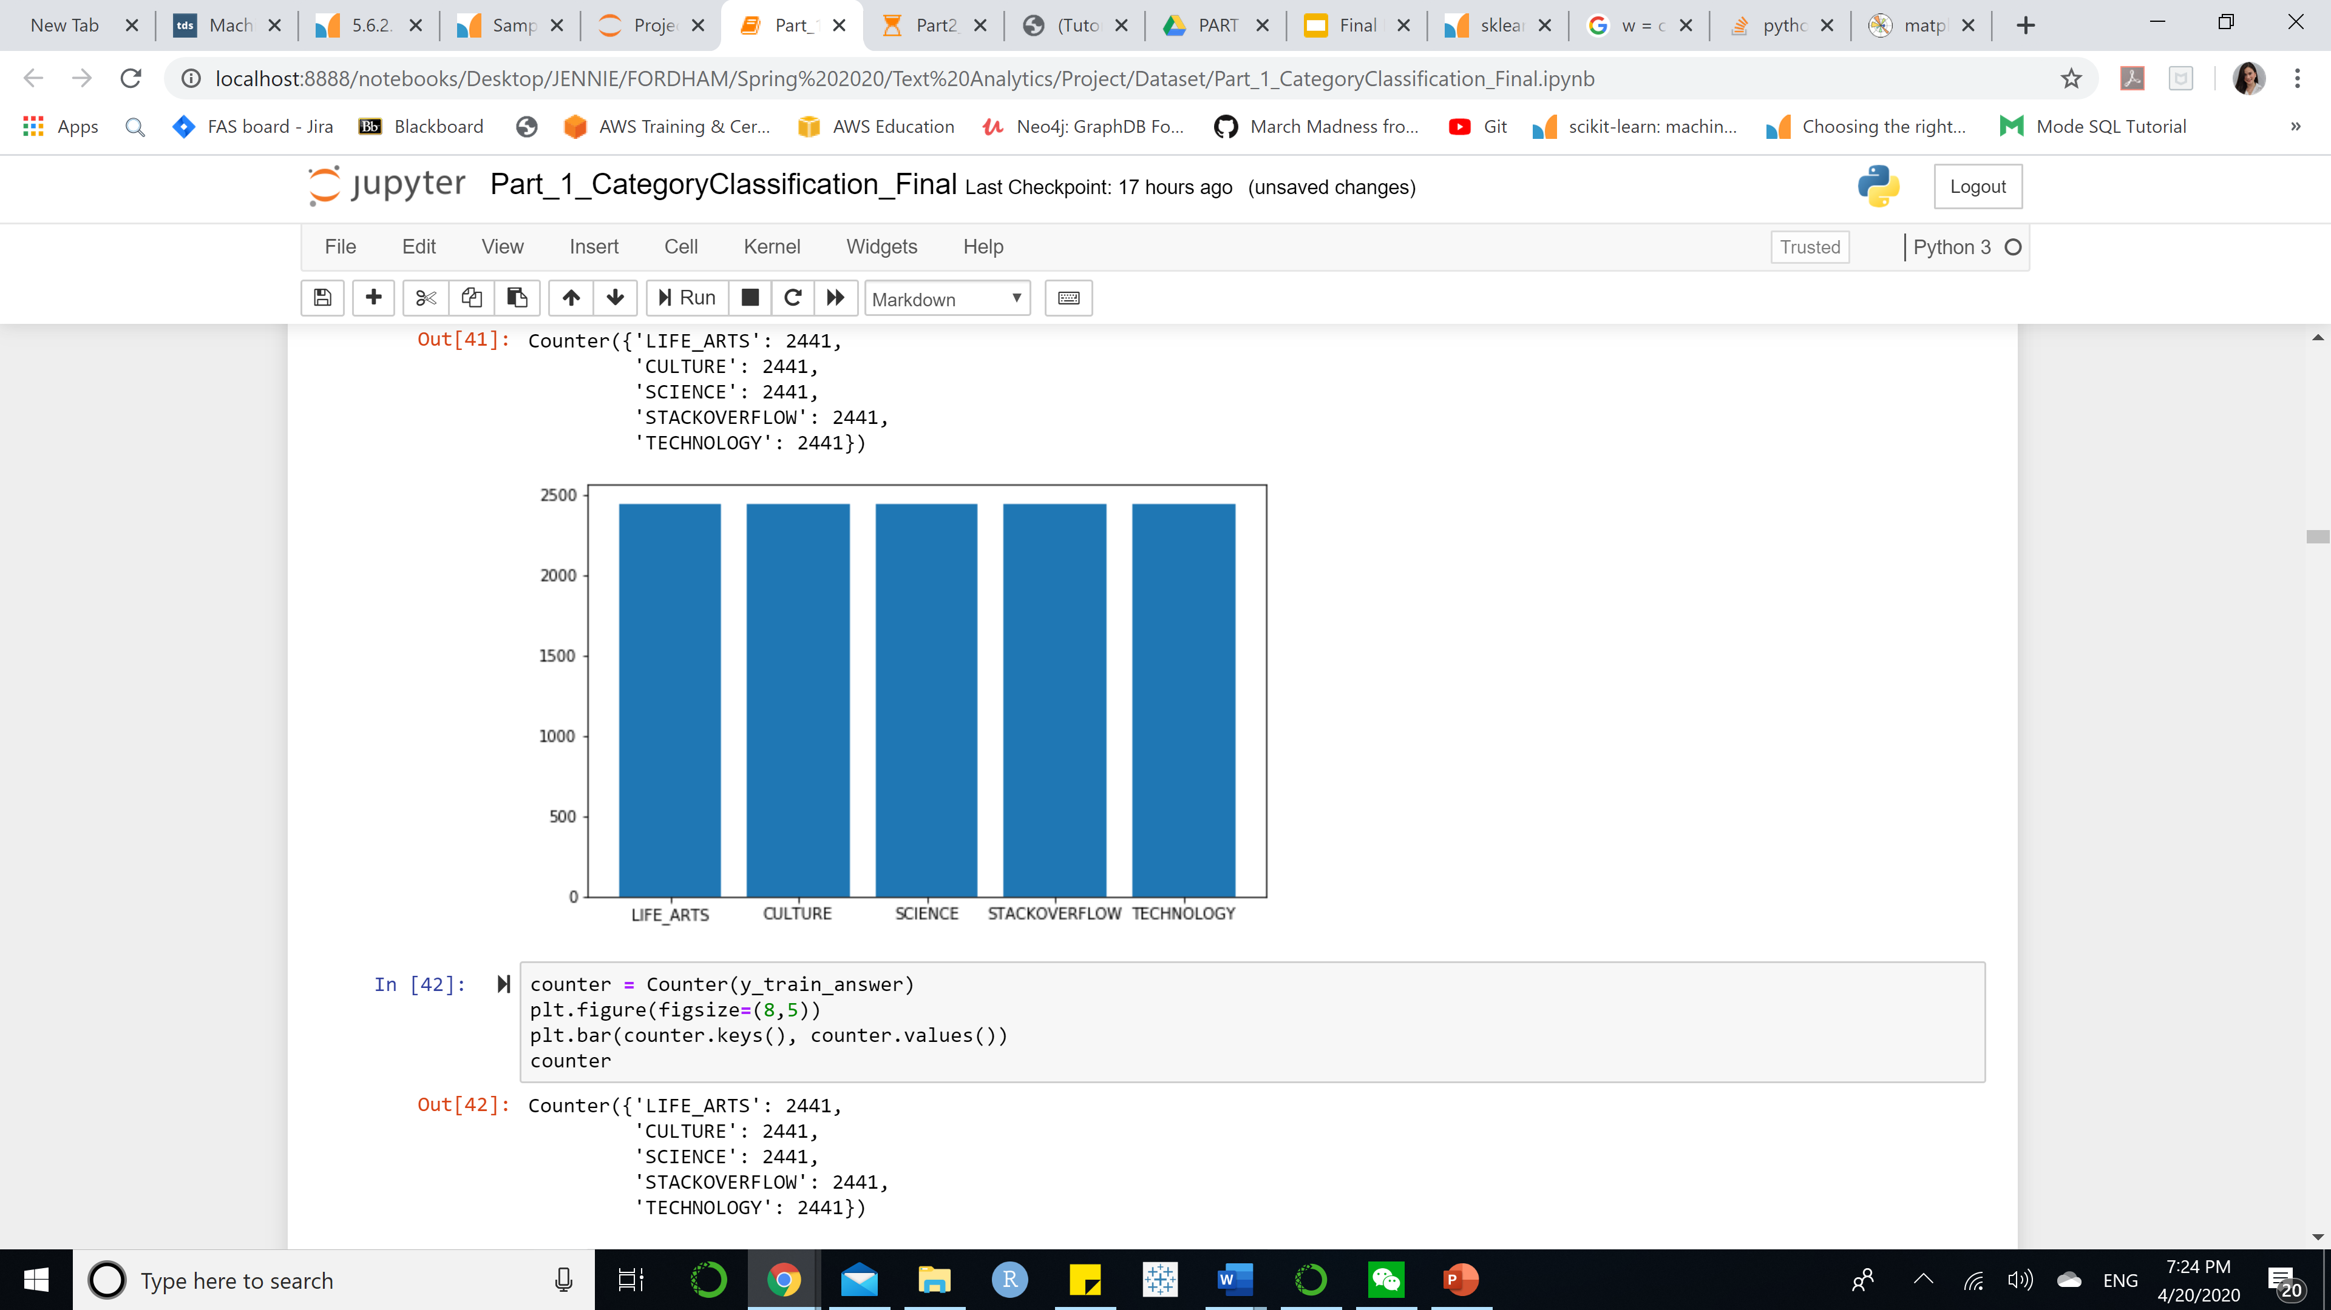
OVERSAMPLING
The method of over sampling are used with SMOTE - This will randomly oversample observations for each category until they are equally distributed among the train data.
Oversampling is only implemented on training data
Example: TFIDF for question in part I after being over sampling

Slide 13
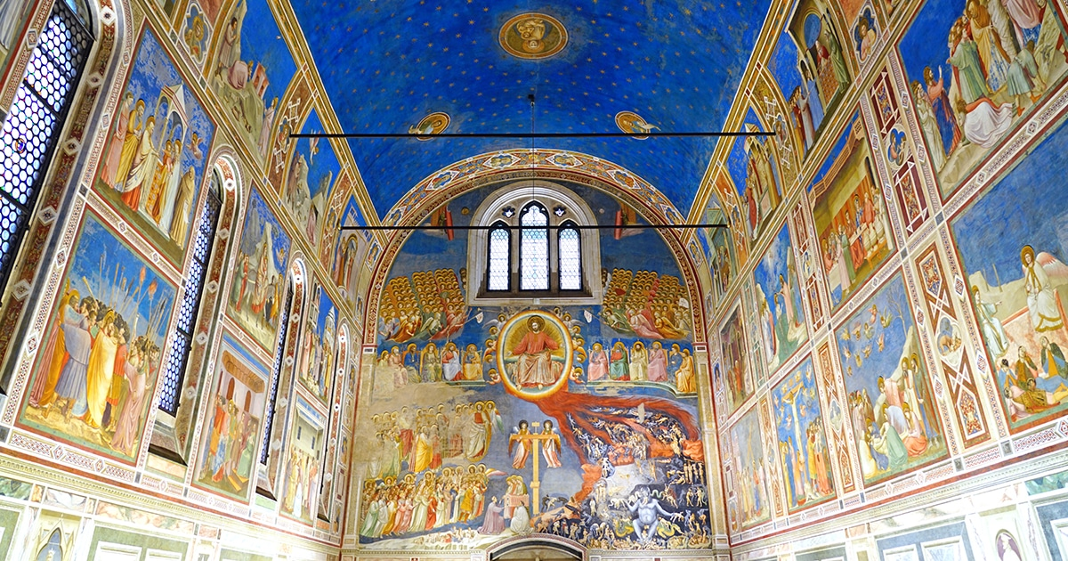



PART I Q&A CATEGORY CLASSIFICATION

Slide 14
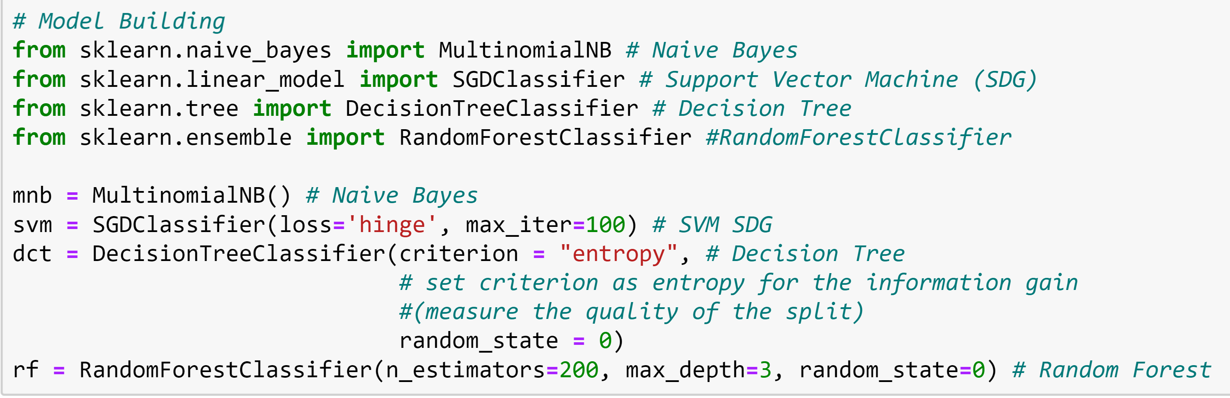
MODEL BUILDING
Models
Bayes Net
Support Vector Machine
Random Forest
Decision Tree
Cross-Validation
5-Fold
Fit each model 5 times to evaluate the accuracy rate
Notes:
Cross validation 5 folds means we will train the model for 5 times

Slide 15
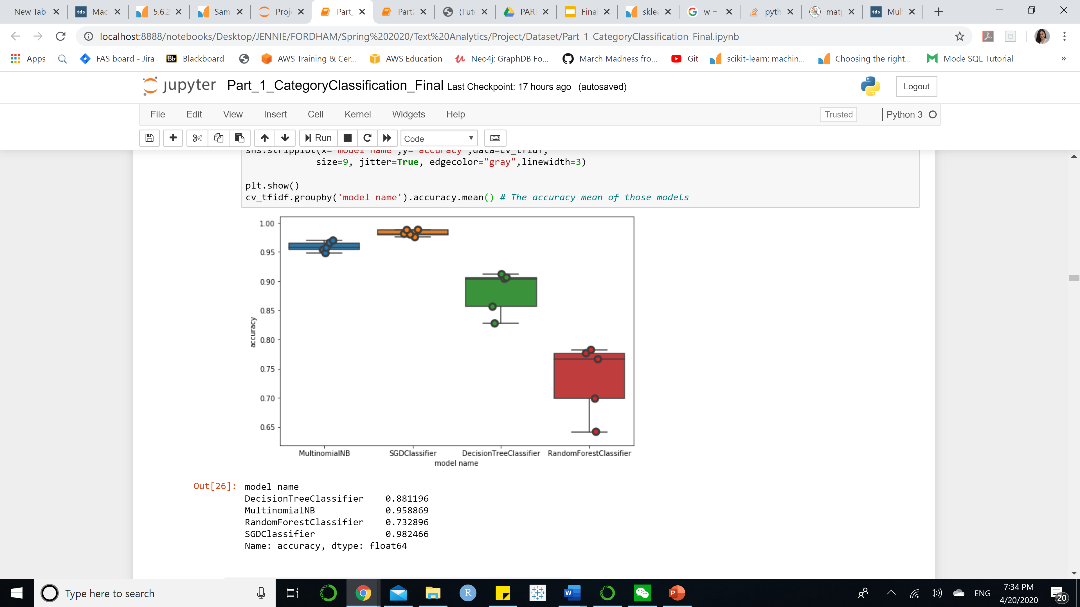
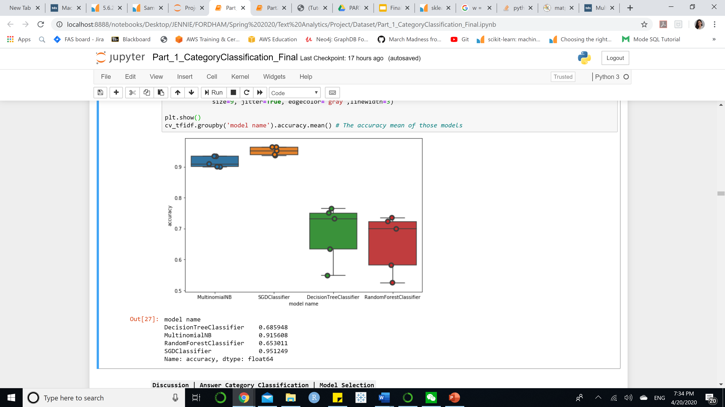
MODEL SELECTION | SUPPORT VECTOR MACHINE
Question | SVM – 98% Accuracy
Answer | SVM – 95% Accuracy

Slide 16
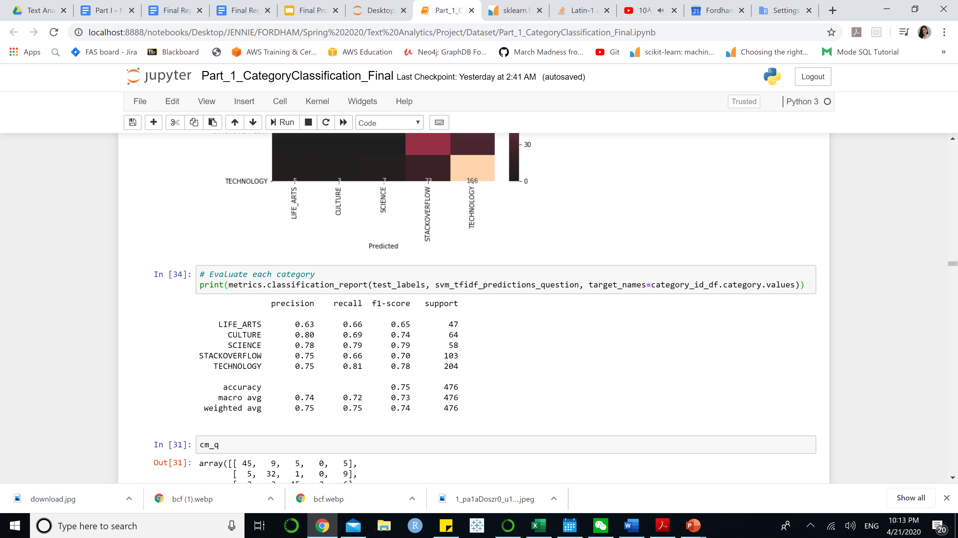
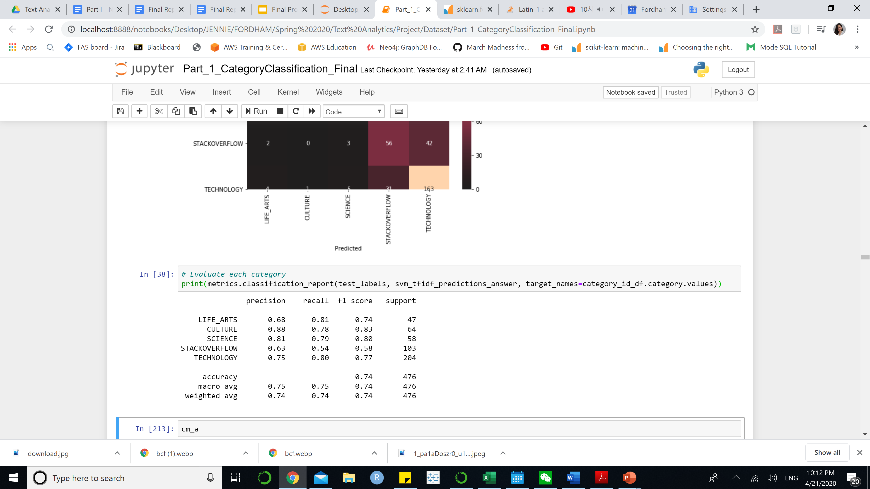
MODEL EVALUATION |PRECISION – RECALL – F1 SCORE
Question
Answer
The model tends to misclassified these two topics
The model seems to predict Culture the best
Notes:
This scores are generated by using testing data

Slide 17
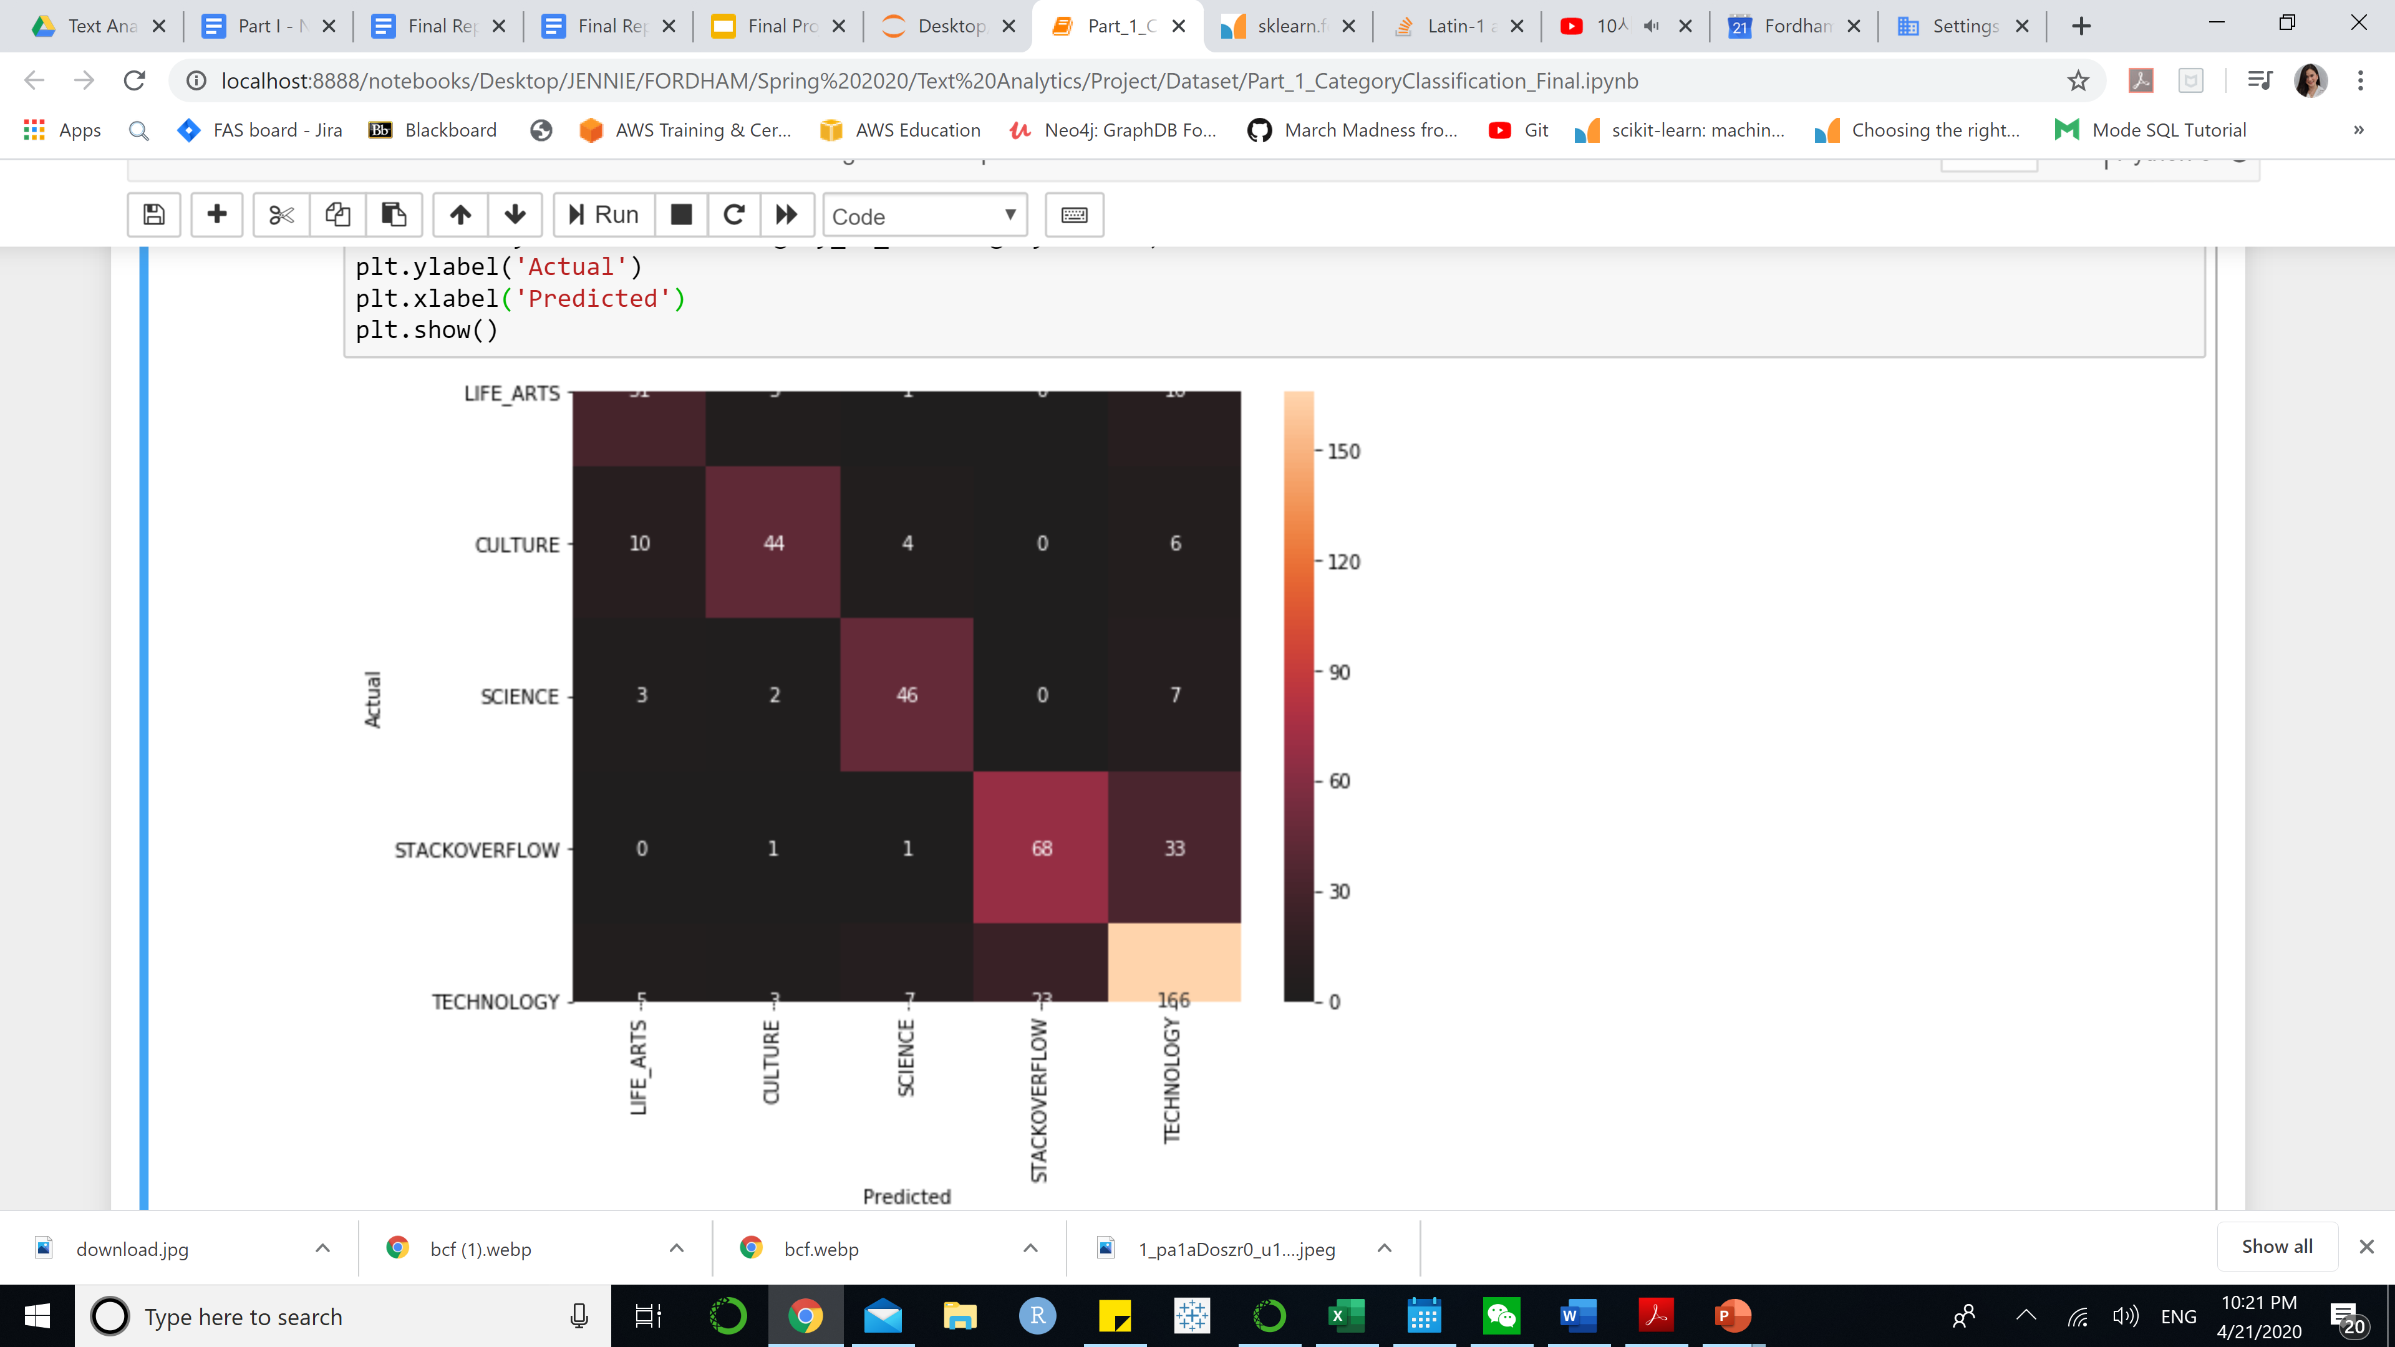
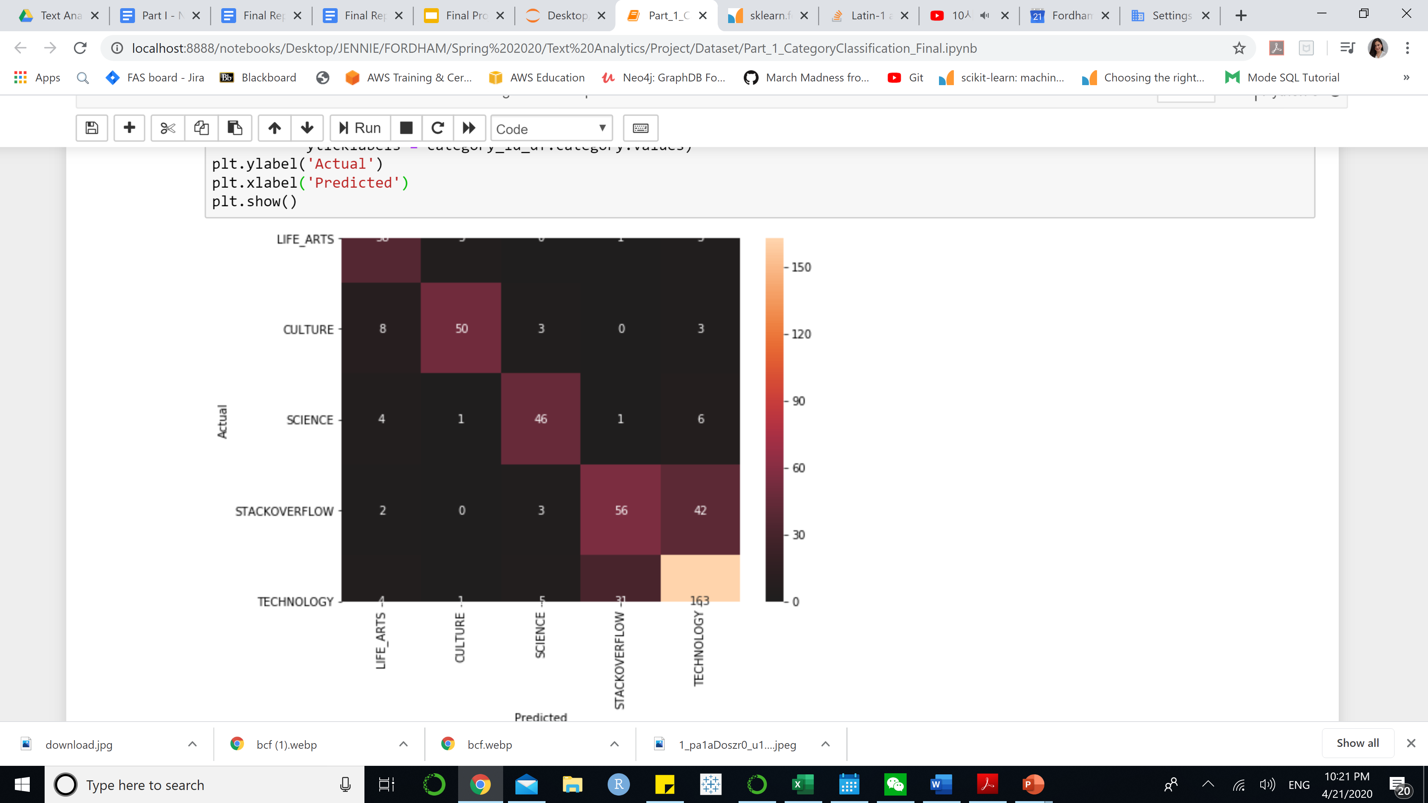
MODEL EVALUATION | CONFUSION MATRIX
Question
Answer
Notes:
Technology and Stackoverflow are likely to be misclassified – the model gets confused between these 2 topic the most

Slide 18
PART 2 Q&A TYPES CLASSIFICATION
Notes:
We also choose to predict the Q&A Types as the separate part of classification

Slide 19
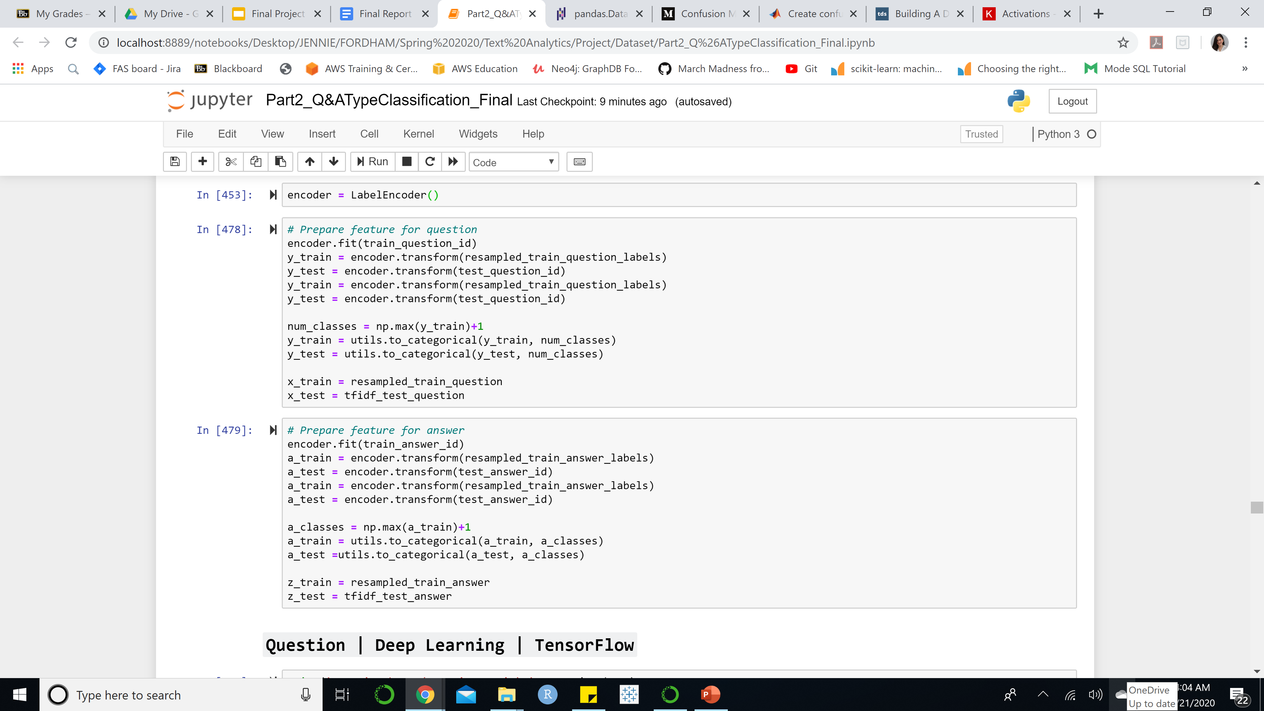
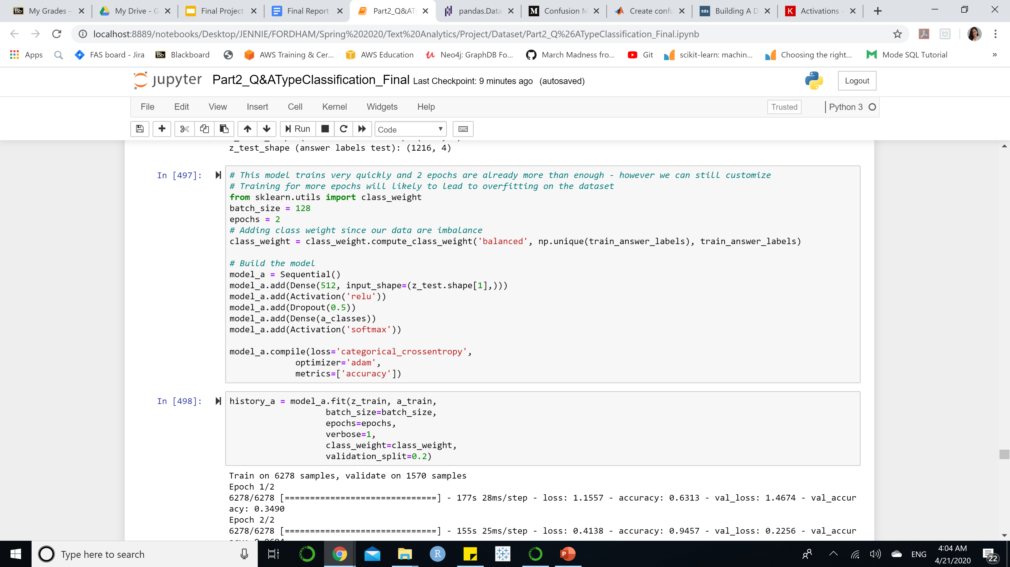
Model Building
LSTM Deep Learning Demo
Question Type Classification Part
Partition 80-20 for training and testing
Models:
Support Vector Machine (TFIDF)
Naïve Bayes (TFIDF)
Long Short-Term Memory (TFIDF)
Features Engineering: one hot encoding target
TFIDF vectorizer as features
Set weight to the model (imbalanced classes)
Train for 2 epochs
Validation dataset is 20% of the data
One hot encoding target – turning those target into dummy variables
Setting weights to the model regarding the target distribution. This can help to deal with unbalanced class problem
Notes:
LSTM is a very powerful model that can help with prediction of classification

Slide 20
MODEL SELECTION
SVM has the
Highest accuracy on testing data
Notes:
Though LSTM has the highest accuracy rate on training data, the testing data is still more important – Therefore we will pick Support Vector Machine for Part 2 – It seems like SVM did better with predicting multi-class classification – We have 10 types of classes

Slide 21
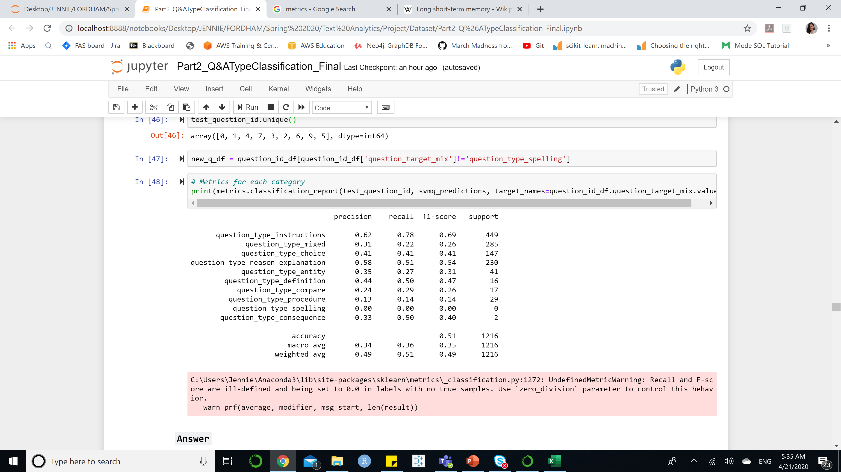
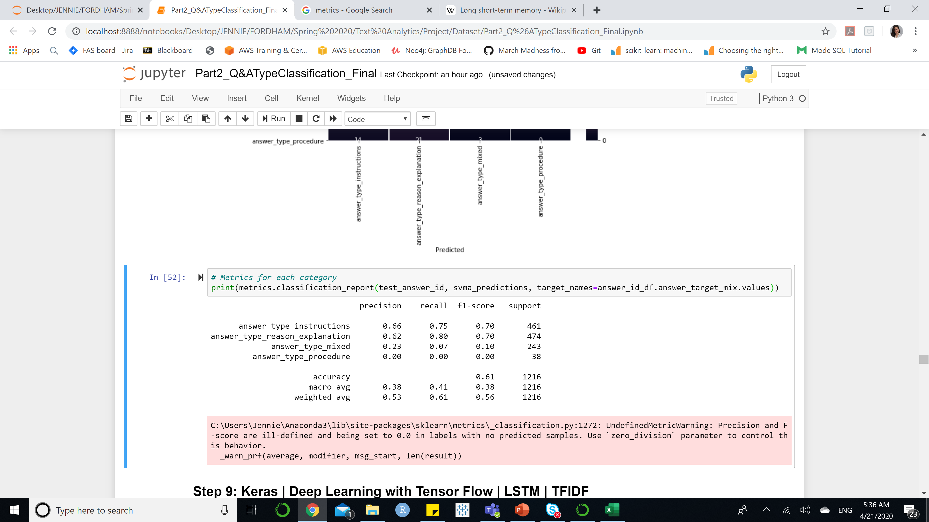
MODEL EVALUATION | PRECISION – RECALL – F1 SCORE
Question Type | SVM
Answer Type | LSTM
Precision Score 49%, recall score 51%, F1 score 49% - Fair Performance with 10 targets.
Baseline Accuracy = 1/10 = 10% - Randomly choose one observation, we have roughly 10% of chance that the guess is right (Probability). Therefore, the recall score and precision score of SVM are not so bad after all.
Precision Score 53%, recall score 61%, F1 score 56% - Fair Performance with 4 targets
Baseline Accuracy = 1/4 = 25% - Randomly choose one observation, we have roughly 25% of chance that the guess is right (Probability). Therefore, the recall score and precision score are not so bad after all. Furthermore, the accuracy is 63%, roughly 3 times of baseline accuracy.

Slide 22
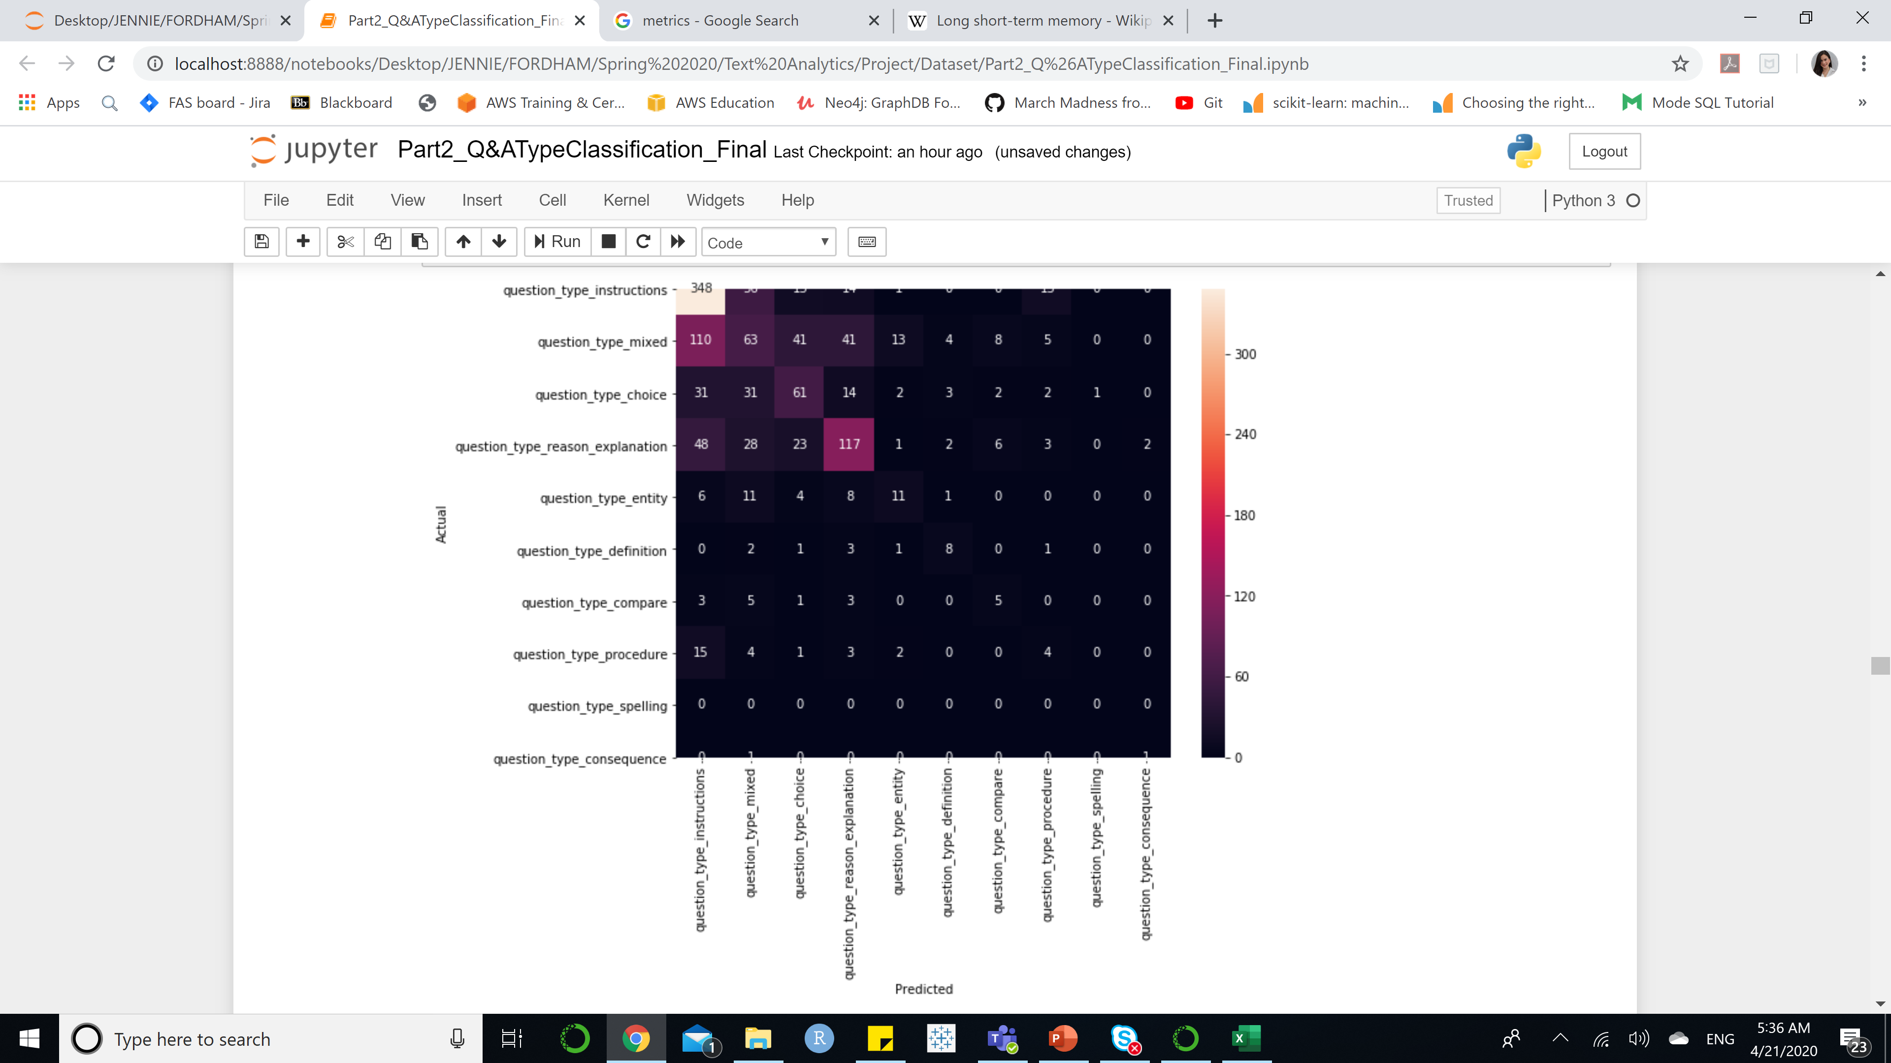
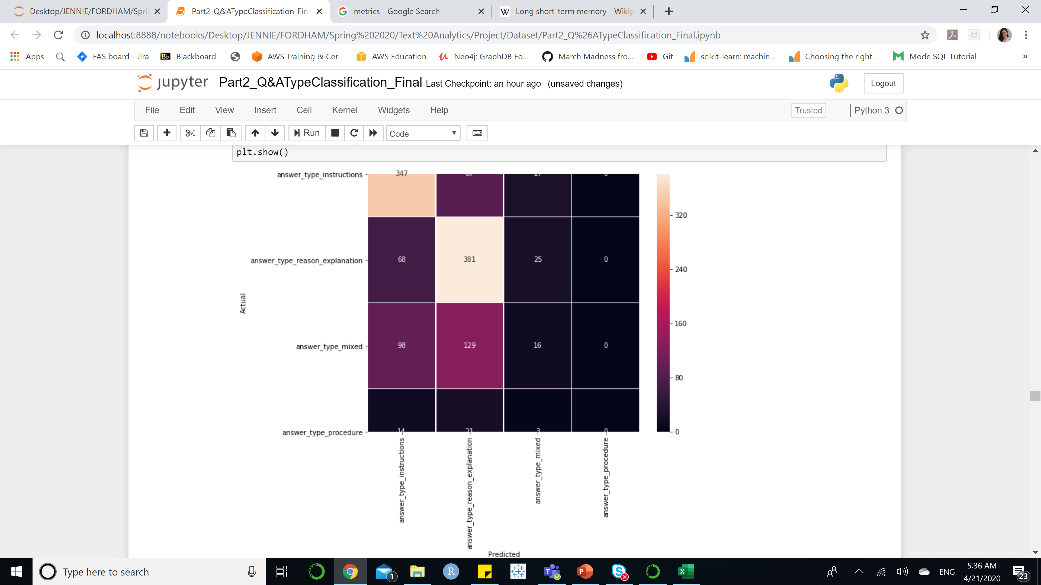
MODEL EVALUATION | CONFUSION MATRIX
Question Type | SVM
Answer Type |LSTM
Notes:
Question, seems like the models can only classify question type instruction and reason explanation the best. At the same time, LSTM can categorize answer type instruction and answer type reason explanation the best because those contains the highest number of observations. The models are actually biased against those

Slide 23
Conclusion
Q&A Topic/Category Classification
1
Model: SVM
Feature: TFIDF + Unigram & Bigram
Question: Accuracy of 98% on Training & Precision of 75% on Testing
Answer: Accuracy of 95% on Training & Precision of 74% on Testing
Q&A Type Classification
2
Feature: TFIDF + Unigram & Bigram
Question Type: SVM – Accuracy of 89.1% on Training & 50.82% on Testing
Answer Type: LSTM – Accuracy of 96.94% on Training & 63.89% on Testing
Model: SVM for Question Type & LSTM Neural Network for Answer Type

Slide 24
Limitation & Recommendation
LIMITATION
Part II – Extremely unbalanced classes between observations. For instance, question_type_spelling only has 2 observations.
The testing data was split from the train data from Kaggle. Therefore, the testing data might not include all types. For instance, question_type_spelling is missing in the testing data for this project. This could affect the accuracy rate on testing set.
For Question & Answer Type target, multiple classes are mixed due to the maximum probability score for each type is the same for multiple observations, which can distract the learning ability of the model.
RECOMMENDATION
Collect more data on each types and retrain the model.
New feature selection, such as POS – part of speech – This feature might consider the structure of sentence, which can relate to the type of question.

Slide 25

Any Question ?

